Slide 1
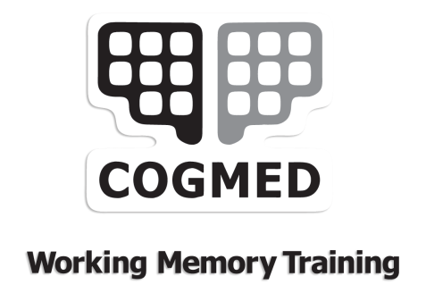
Cogmed Working Memory Training™
Informational Webinar

Slide 2

Cogmed Working Memory Training™
Agenda
Foundations of Cogmed
What is working memory?
Cogmed Working Memory Training
Who is Cogmed for?
The Cogmed programs
Cogmed Training Method
What does the research say?
Demonstration of the programs

Slide 3
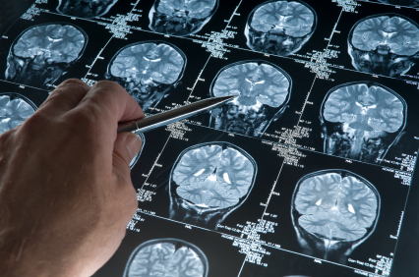
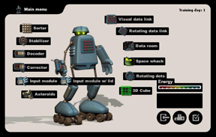

Cogmed combines three different fields into one program
Neuroscience, Game Development & Psychology
Founded in 2001 by brain researchers at the Karolinska Institute
Dedicated to developing and marketing only evidence-based products
Offices in Northern New Jersey and Stockholm
First paying client in 2003 (Sweden), introduced to the US in 2006
Travis Millman is GM; Torkel Klingberg, MD, Ph.D, is Chief Scientific Advisor

Slide 4
Cogmed Working Memory Training™
Agenda
Foundations of Cogmed
What is working memory?
Cogmed Working Memory Training
Who is Cogmed for?
The Cogmed programs
Cogmed Training Method
What does the research say?
Demonstration of the programs

Slide 5

What is Working Memory?
A system for temporary storage and manipulation of information, necessary for wide range of cognitive tasks
The ability to keep information in your mind for a short period of time (seconds) and be able to use the information in your thinking

Slide 6
Working memory is an essential function in every day life
Working Memory
Attention
Impulsivity
Academic Success
Hyperactivity
Concentration
Organization
Manipulates information
Delegates task relevant responses
Allows us to block out unnecessary information
It keeps us updated on what’s happening – and keeps us focused on what matters

Slide 7
Cogmed Working Memory Training is a evidence based intervention
Research
Cogmed is backed by peer reviewed, published, and fully independent studies
Network
The Cogmed Network is made up of highly qualified, PhDs, Licensed Psychologists and Psychiatrists, M.D.s
Track Record
Cogmed training has a very high compliance rate to go along with its proven results
Notes:
B

Slide 8
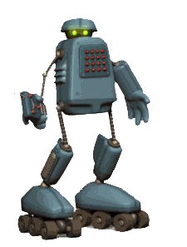
What makes Cogmed work?
1. Scientific – designed by leading neuroscientists
5. Supported – your coach will be there
6. Targeted – wm only
4. Sustained – 25 sessions
2. Adaptive - in real time
3. Intensive – hard work

Slide 9
Cogmed Working Memory Training™
Agenda
Foundations of Cogmed
What is working memory?
Cogmed Working Memory Training
Who is Cogmed for?
The Cogmed programs
Cogmed Training Method
What does the research say?
Demonstration of the programs

Slide 10



Who can benefit from Cogmed?
Anyone constrained by their working memory
1. Born with a deficit
2. Acquired a deficit through brain injury or disease
3. Developed a deficit through natural decline caused by age
Children
Adults
Seniors
Experiencing a bottleneck due to wm overload

Slide 11

Education
Working memory is key for academic performance
10-15% of all students have working memory deficits
Students with working memory deficits perform below average in all areas of learning
Working Memory is crucial for math, reading comprehension, complex problem solving and test taking

Slide 12



Multiple failure points in the life of the working memory deprived
Age
School
Higher Education
Career
Fitting in
Learning to read
Getting into college
Graduating
Promotion
Achieving goals
Challenge

Slide 13
Cogmed Working Memory Training™
Agenda
Foundations of Cogmed
What is working memory?
Cogmed Working Memory Training
Who is Cogmed for?
The Cogmed programs
Cogmed Training Method
What does the research say?
Demonstration of the programs

Slide 14
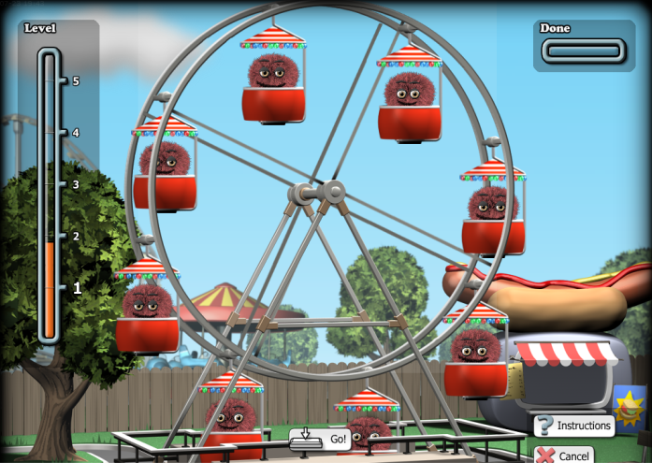
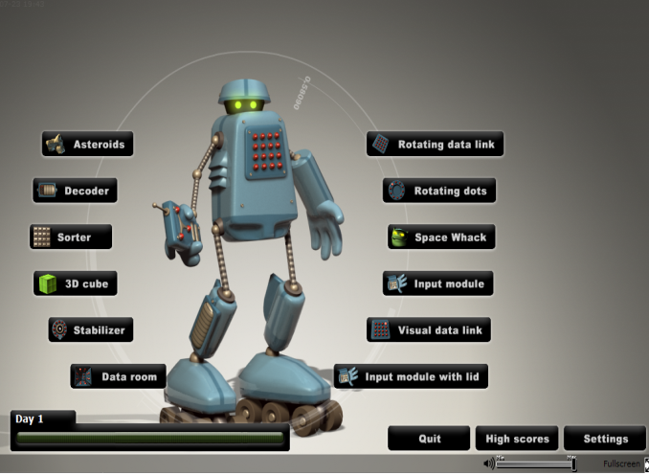
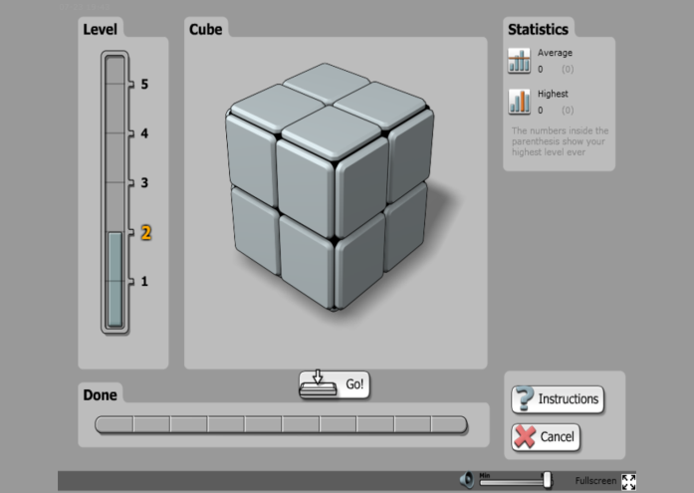
Three programs for Cogmed training
Cogmed JM
preschoolers
Cogmed RM
school-age children
Cogmed QM
adults
All the products share the same underlying design – the only difference is in the user interface

Slide 15

Cogmed Training – the basics
Training done at home – Mac or PC
Supported by a coach from a Cogmed practice
Five weeks of training – five times per week (25 sessions)
Every session is 30-40 minutes
The results tracked online on the Cogmed Training Web
After intensive training: Cogmed Extension Training

Slide 16

Cogmed is a highly structured, supportive process
1. Structured interview
2.
Start-up session
3.
25 training sessions, weekly coach calls
4.
Wrap-up session
5. Extension training (optional)

Slide 17

Framework for understanding
Cogmed research
Cogmed is a highly structured, supportive process
1. Structured interview
2.
Start-up session
3.
25 training sessions, weekly coach calls
4.
Wrap-up session
5. Extension training (optional)

Slide 18






































Notes:
Please Note: This slide contains animations

Slide 19

The research breakthrough – your working memory capacity is not fixed
Working memory can be improved by intensive and systematic training
The improvement translates to improved attention
The effects are strong and lasting

Slide 20
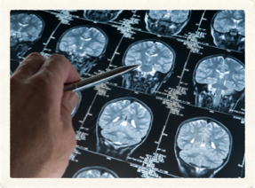
Cogmed Products have been tested in rigorous research
Cogmed is based on a breakthrough in basic research (Klingberg et al., 2002)
The same products/protocols used in real life are used in the research
The research uses controlled studies – eliminating placebo effects
The research is done at leading universities:
by Cogmed founders
by independent research teams
To learn about how our research stands out, visit: www.cogmed.com/research and discuss with a professional you trust to get a second opinion.

Slide 21
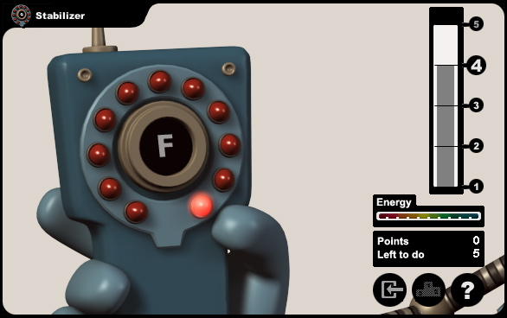
A note on adaptive vs. non-adaptive Cogmed training
Non-adaptive training (placebo):
- same interface as Cogmed RM
limited to 2 or 3 items per span
same number of items per trial
not challenging WM capacity
b/c training with low WM load
Adaptive training:
requires maintenance of multiple stimuli simultaneously
short delays during which representation of stimuli should be held in WM
unique sequencing of stimuli order in each trial
difficulty level adapting as function of individual performance
  correct trial: sub-level increase, more difficult span arrangement, more items per span
  incorrect trial: almost right – small decrease, not even close – large decrease

Slide 22


A note on trained vs. non-trained WM tasks
Trained visuo-spatial WM task
Simple span forward
Presentation mode: Computerized
Stimuli: Grid, circles light up
Stimuli configuration: Regular 4 x 4 grid
Response mode: Mouse click
Non-trained visuo-spatial WM task
Simple span forward
Presentation mode: Real blocks
Stimuli: Blocks on a board
Stimuli configuration: Irregular pattern
Response mode: Hands on

Slide 23
Key research findings to date
Working memory is key to attention, executive function
Working memory can be improved by training, using right tool/protocol
Working memory can be improved at all age levels
The improvement can be tracked by on three levels: fMRI/PET, neuropsych testing, and by rating scales
Improved working memory generalizes to behavioral improvement
The behavioral improvement is sustained
Training effects are pronounced in populations with a WM constraint, effects not limited to ADHD

Slide 24

24 Cogmed training studies published + 2 Reviews
Including:
Randomized,
Placebo controlled,
Double blinded*
Independent researchers*
Review articles *

Slide 25
Published studies cover range of ages & profiles
Population
Typical
ADHD/
Low/WM
Special needs
Brain Injury/Stroke
Developmental/Psychiatric Problems
Klingberg et al., 2002 (exp. 2)
Olesen et al., 2004
Westerberg & Klingberg, 2007
McNab et al., 2009
Brehmer et al., 2009; 2011; 2012
Bellander et al., 2011
Thorell et al., 2008
Bergman-Nutley et al., 2011
Söderqvist et al., 2011
Klingberg et al., 2002,2005
Holmes et al., 2009 , 2010
Gibson et al., 2010
Mezzacappa et al., 2010
Beck et al., 2010
Dahlin, 2011
Westerberg et al., 2007
Lundqvist et al., 2010
Johansson & Tornmalm, 2011
Kronenberger et al.,2010
Løhaugen et al., 2010
Roughan & Hadwin, 2011
Preschoolers Children/ Adolescents Adults Adults Over 50

Slide 26
Key Research Study (I) | Key learning
Klingberg et al., 2002 J. Clinical and Experimental Neuropsychology | Children with ADHD improve on neuropsychological tests after WM training.
Westerberg et al., 2004 ** Child Neuropsychology | Visuo-spatial working memory is a core deficit in ADHD.
Olesen et al., 2004 Nature Neuroscience | Increased activity in brain following Cogmed Working Memory Training (instead of less).
Klingberg et al., 2005 JAACAP | Klingberg et al., 2002 data validated in larger, multi-site study adding three month follow-up and rating scale data.
Westerberg & Klingberg, 2007 Physiology & Behavior | Healthy adults show increased brain activity in pre-frontal cortex and improved WM capacity after Cogmed.
Westerberg et al., 2007 Brain Injury | Adult victims of stroke self-report decreased cognitive problems in daily life and show far transfer after WM training.
Brehmer et al., 2009 Neuroscience Letters | Dopamine transporter (DAT1) gene displays polymorphism with DAT 9/10 and DAT 10 variations. DAT 9/10 carriers have greater training related gains in visuo-spatial WM post Cogmed.

Slide 27
Key Research Study (II) | Key learning
Holmes et al., 2009 Developmental Science | Children with low WM improve WM, attention, and math six months after training.
McNab et al., 2009 Science | Healthy adults exhibit changes in dopamine D1 binding after Cogmed Working Memory Training.
Thorell et al., 2009 Developmental Science | Preschoolers improve WM w/ near and far transfer, to better attention; inhibitory control training shows no result transfer/ generalization.
Holmes et al., 2010 Applied Cognitive Psychology | Six months lasting effects on WM in children with ADHD, wider effect on executive functions than stimulant medication.
Mezzacappa & Bruckner, 2010 School Mental Health | Children in low SES school setting improve WM and have decreased teacher ratings of ADHD symptoms.
Beck et al., 2010 Journal of Clinical Child & Adolescent Psychology | Parents and teachers report improved WM, EF, and ADHD symptoms in children on BRIEF and Conner’s rating scales.
Kronenberger et al., 2010 Journal of Speech, Language, and Hearing Research | Cogmed is feasible intervention for hearing impaired. Transfer of WM improvement to language skills.

Slide 28
Key Research Study (III) | Key learning
Lundqvist et al., 2010 Brain Injury | Heterogeneous group of brain injured adults improve WM and self- rated occupational performance.
Dahlin, 2011 Reading and Writing | Special needs children improve reading comprehension.
Gibson et al., 2011 Child Neuropsychology | WM is dissociated system consisting of SM and PM. ADHD children improve on parent reported behavioral symptoms after Cogmed.
Bergman Nutley et al., 2011 Developmental Science | Preschoolers improve WM capacity after Cogmed. Gf improved by non-verbal reasoning training but not by WM training.
Løhaugen et al., 2011 The Journal of Pediatrics | Children born at extremely low birth weight improve WM with transfer to verbal learning ability
Brehmer et al., 2011 NeuroImage | Older adults improve WM, sustained attention, and episodic memory after training. Greater decreases in neocortical activity and increases in sub-cortical activity that were related to the size of training gains (performance).
Bellander et al., 2011 Neuropsychologia | Individual variations in LMX1A gene determine the proliferation, differentiation and survival of DA producing neurons in the brain and impact training related gains in verbal WM.
Johansson & Tornmalm, 2012 Scandinavian J. of Occupational Therapy | Heterogeneous group of brain injured adults self-report decreased cognitive failures (CFQ) and improved occupational performance and satisfaction (COPM). Users with worst deficit at baseline improved most after Cogmed

Slide 29
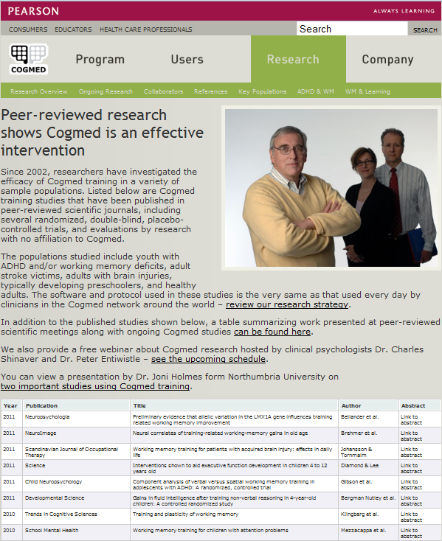
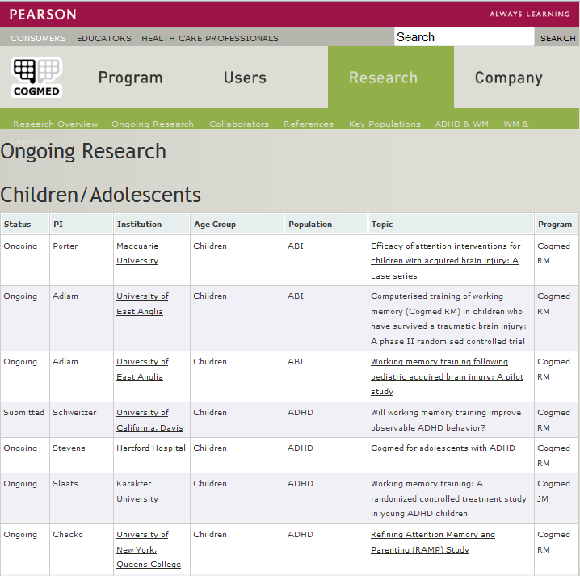
Notes:
Please Note: This slide contains animations

Slide 30
Wide Range of Studies Ongoing
PI | Institution | Age Group | Population
Porter | Macquarie University | Children | ABI
Adlam | University of East Anglia | Children | ABI
Slaats | Karakter University | Children | ADHD
Chacko | City University of New York, Queens College | Children | ADHD
Schweitzer | University of California, Davis | Children | ADHD
Jarrett | University of Alabama | Children | ADHD & Anxiety
Beernink | de Bascule | Children | ADHD
Hadwin | University of Southampton | Children | Anxiety
Hardy | Children’s National Medical Center | Children | Brain Tumor
Hardy | Children’s National Medical Center | Children | Cancer
Carlson-Greene | Children’s Hospitals & Clinics of Minnesota | Children/Adolescents | Cancer
Løhaugen | Norwegian Institute of Science and Technology | Children | Cerebral Palsy
Bennett | University of Porstmouth | Children | Down syndrome
Walda | Radboud Univeristy | Children | Dyselxia
Berl | Children’s National Medical Center | Children | Epilepsy
MacAllister | New York University | Children/Adolescents | Epilepsy
Schweitzer | University of California, Davis | Children/Adults | Fragile X
Holtrop | Wayne State University | Children | Lead poisoning
Quach | Royal Children's Hospital | Children | Low WM
Chang & Skranes | University of Hawaii | Children | Prenatal Drug Exposure
Skranes | Norwegian University of Science and Technology | Children | Preterm

Slide 31

The Cogmed Network is ready to explain more - and to help you
Cogmed only available through Cogmed Qualified Practices
About 400 Cogmed Qualified Practices across North America
All practices and Cogmed coaches trained by Cogmed
All experienced in assessing & helping people with attention problems

Slide 32
Thank You
Stay on for a demonstration of the programs

